Slide 1
Lead Scoring Case Study
Submitted By:
Rishab Prasad

Slide 2
Business Objective
To help X Education to select the most promising leads, i.e. the leads that are most likely to convert into paying customers.
To build a logistic regression model to assign a lead score value between 0 to 100 to each of the leads which can be used by the company to target potential leads.

Slide 3
Problem Statement
Company
Context
Problem statement
X Education is an online education company that sells online courses to industry professionals.
The company does marketing of its courses on various websites and search engines such as Google. Once the visitors land on the website, they browse through different courses or fill up a form for the course or watch related videos. When the visitors fill up a form and provide their contact details, they are classified as leads.
X Education gets a lot of leads, the lead conversion rate is low i.e., about 38%. The company wants to identify the best leads,
i.e. the leads that have high conversion probability. The company wants to assign a lead score to each lead. The customers with a higher lead score have a higher conversion probability and the customers with a lower lead score have a lower conversion probability.

Slide 4
Data Cleaning
Dropping redundant columns
Imputing missing values
Handling Null values
The columns with more than 40% of null values were dropped
The columns with redundant informations were dropped
The numerical columns are imputed with median and categorical columns are imputed with mode
How did you hear about X Education (78.46%)
Lead Profile(74.18%)
Lead Quality (51.60%)
Asymmetrique Profile Score, Asymmetrique Activity Score, Asymmetrique Activity Index, Asymmetrique Profile Index (45% for all four)
Updates
Last_activity
Prospect_ID

Slide 5
EXPLORATORY DATA ANALYSIS

Slide 6
Univariate Analysis

Slide 7
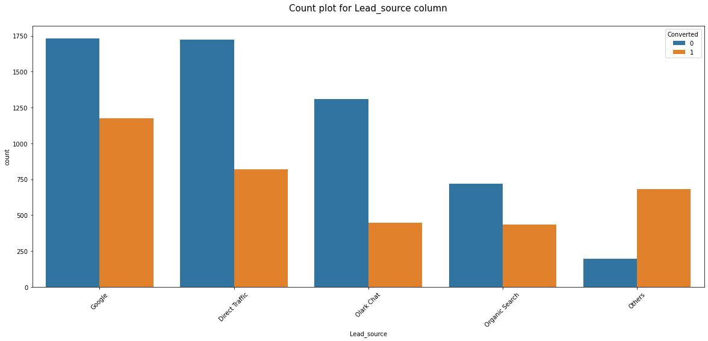
Leads sourced from Google or Direct Traffic will have high conversion rate

Slide 8
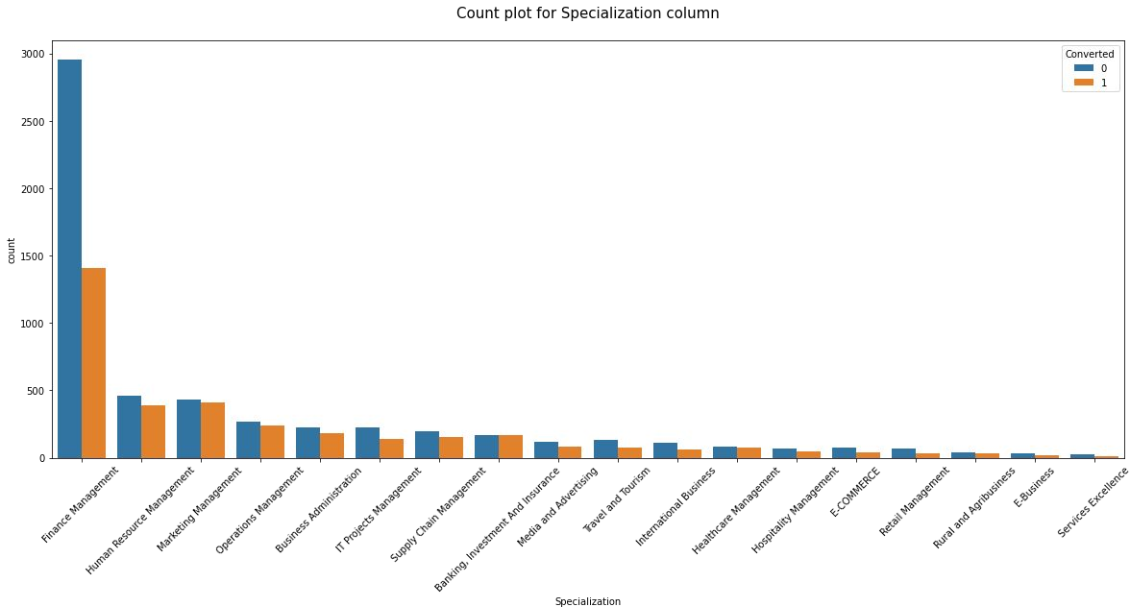
Lead from Finance management specialization having highest conversion rate.

Slide 9
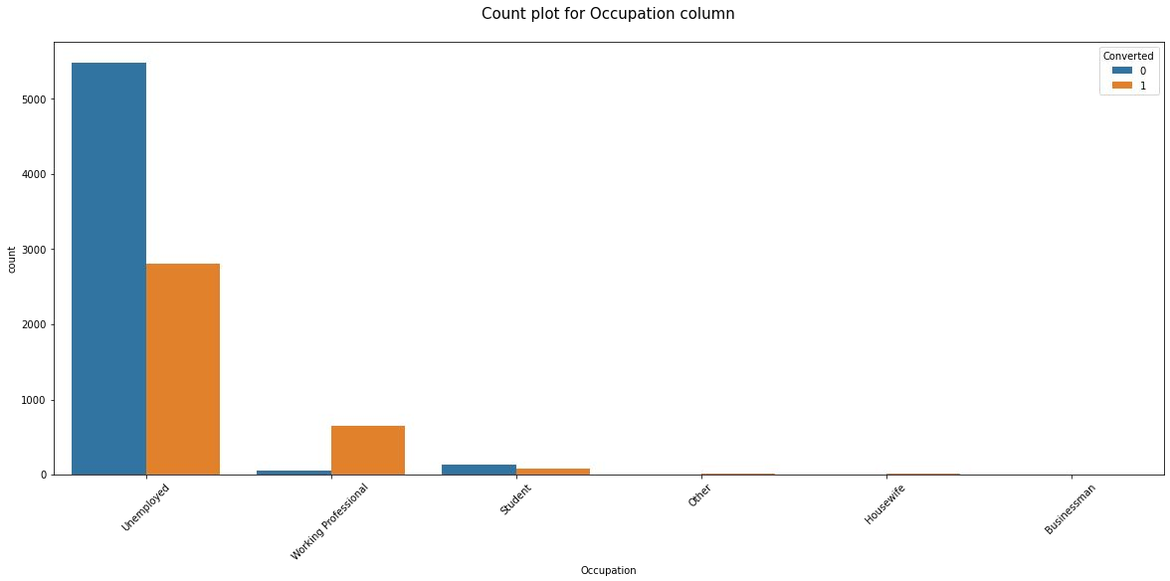
Leads with occupation type as Working professional will have high conversion rate.
We are having the highest converted leads from the unemployed occupation type but the conversion ratio is less than 50%

Slide 10
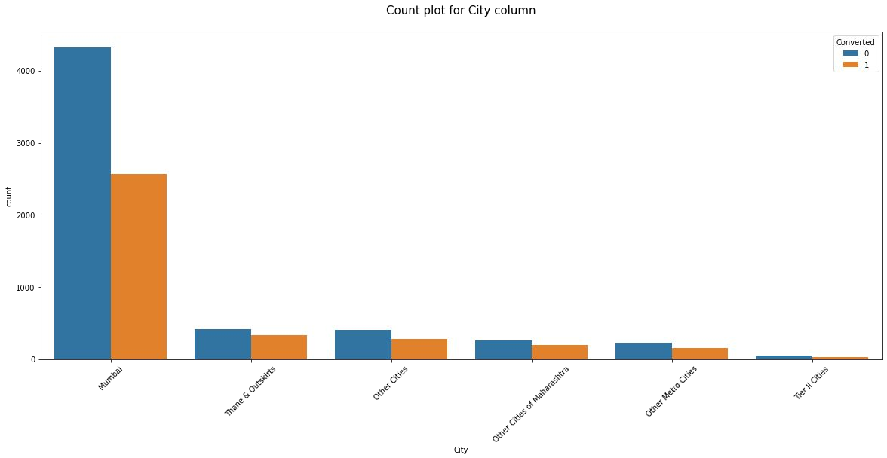
Most of the leads are from the Mumbai city and having the conversion ratio more than 50%.

Slide 11
Univariate Analysis - Inferences
Lead origin
Maximum leads are originated from Landing Page Submission and API
Conversion rate is also high from these
Lead Source
Maximum leads are sourced from Google and Direct Traffic
Conversion rate is also high for these
Most of the leads have opted for email and phone call communications
Country
~96% of leads are from India
Specialization
Most of the leads have
Occupation
Finance and Human Resource Management
specialization
85% of leads are unemployed with high conversion rate
Reason_for_Choosing
~99% of leads are choosing the platform for better career prospects
City
Most of the leads are from Mumbai with high conversion rate

Slide 12
Bi-variate Analysis

Slide 13
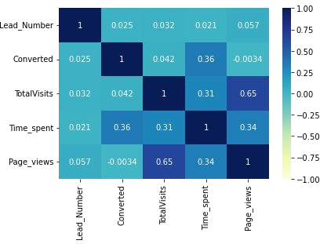
Correlation
There is high positive correlation between TotalVists and Pages viewed per visit
Time spent is positively correlated with the Converted, Page views and Total Visits.
Page views is negatively correlated with Converted

Slide 14
Bi-variate Analysis - Inferences
Numeric-Numeric
There seems to be a linear relationship between
TotalVisits
and
Pages vewed per visit
Numeric-Categorical
Leads who are sourced from organic search have high page views per visit and have the highest conversion, followed by Google and Direct Traffic
Leads who are sourced from organic search have spent most of the time on website and have the highest conversion, followed by Google and Direct Traffic
Leads who are sourced from organic search have most number of visits on the website and have the highest conversion, followed by Google and Direct Traffic
Leads who are choosing the services for better prospects have high conversion

Slide 15
Model Details

Slide 16
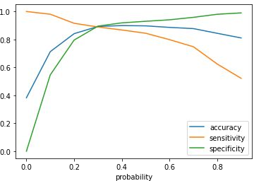
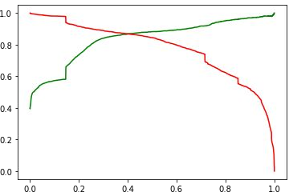
Model Evaluation - Train Dataset
The graph shows the optimal cut off of 0.3 based on Accuracy, Sensitivity and Specificity.
The graph shows an optimal cut off of 0.4 based on Precision and Recall

Slide 17
Model Metrics - Test Dataset
Confusion Matrix
3692 (TN) | 278 (FP)
383 (FN) | 2077 (TP)
Accuracy
Sensitivity
Specificity
89%
86%
91%
Precision
Recall
86%
86%

Slide 18
The leads having high ‘Lead Score’ can be focused on more for better conversion rate.
Marketing on Google, since the conversion rate
from the traffic from Google is high.
Encouraging existing converted leads for
referrals by providing some incentives for the referrals.
Since the number of leads is high in Mumbai as
compared to other major cities, the company can increase marketing in the other cities as well to achieve more leads.
The unemployed category can be focused on
more and also individuals having Finance Management as specialization.
Focus on the students can be minimized since
the conversion rate is significantly low.
Conclusion

